Slide 1
Day 2
SESSION 2.5 | 13:30-14:30 | INTRODUCTION TO THE INTERNET OF THINGS (IOT) AND APPLICATIONS | PRESENTATION

Slide 2
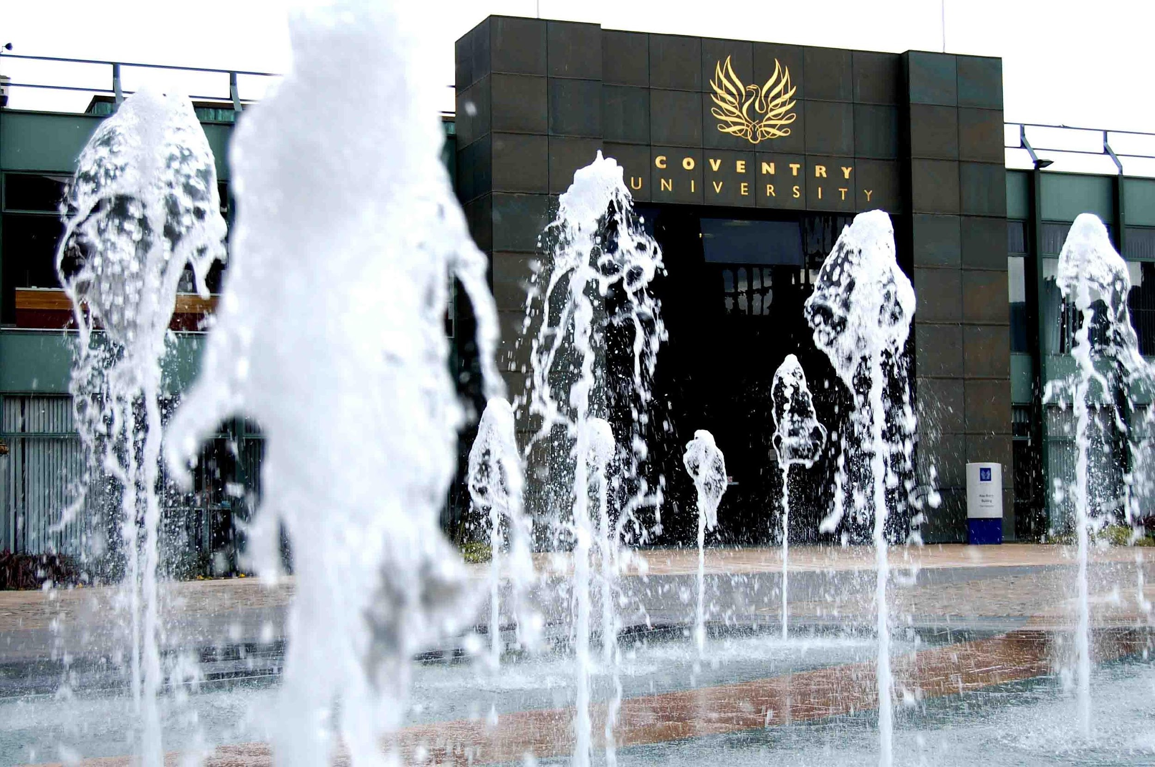
http://www.frankie-lassut.com/COV%20UNI%20FOUNTAINS2.jpg

Slide 3
The speakers
Part of Cogent Labs, FMFM FRC, Coventry University
Team of 3 staff, with Dr. Wilkins (RA)
Complementary expertise – engineering and computer sciences
Supervising 13 PhD students and completed 12
Working to effect real and positive change
Delivered over 20 externally funded WSN/IoT projects
Currently running 4 projects – value approx £2mil to the lab

Slide 4
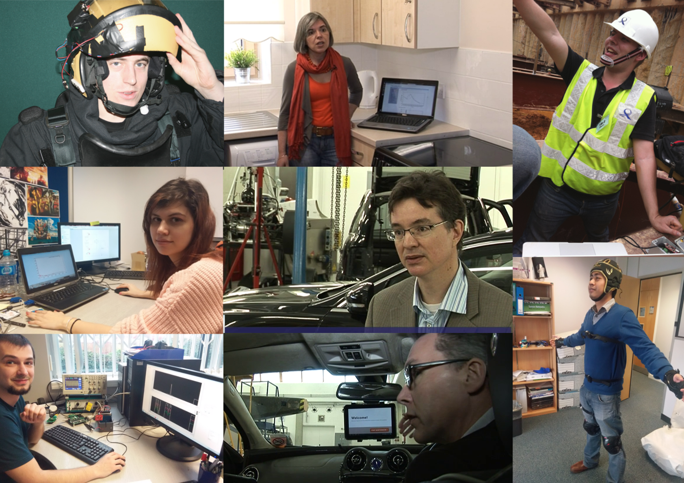
What do we like doing…
Explosive ordnance
disposal
Cogent House
Restructure
Strive
Stargate
Falls and
pre-falls
detection

Slide 5
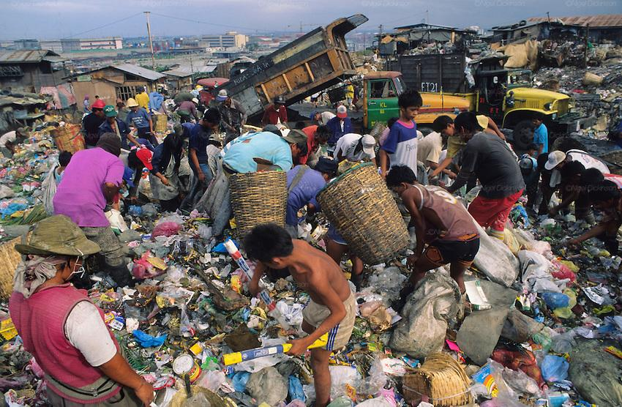
Human Challenges: from Waste to Wealth – Philippines – Mango drying factory automation

Slide 6
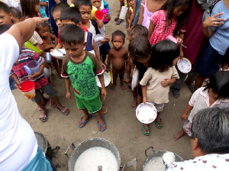
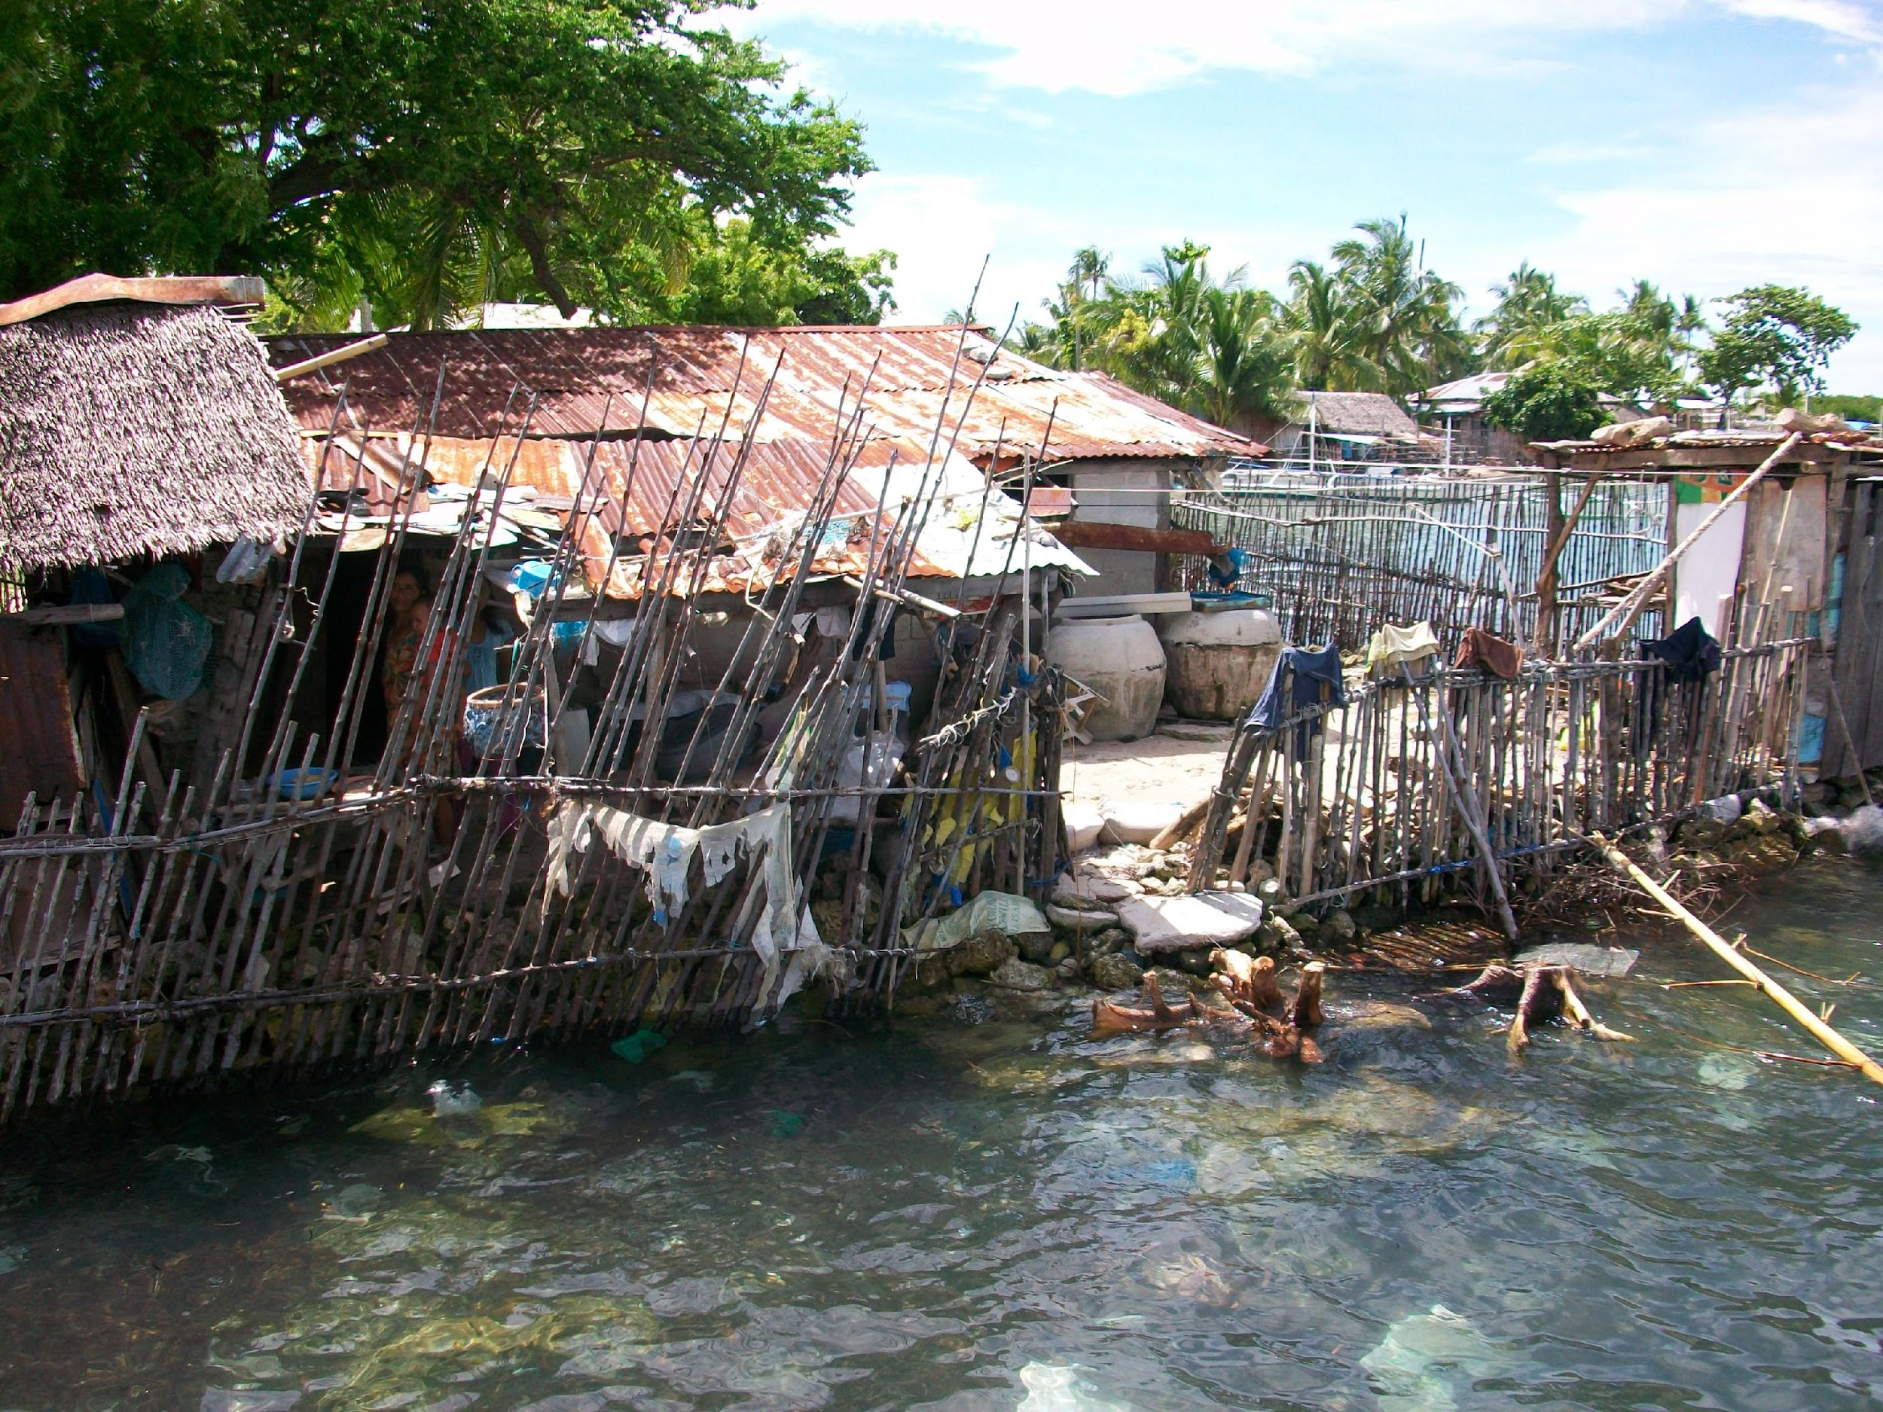
Human Challenges: Energy- Community Controlled Microgrids – Philippines, the Amazon, Rwanda and possibly Nepal

Slide 7
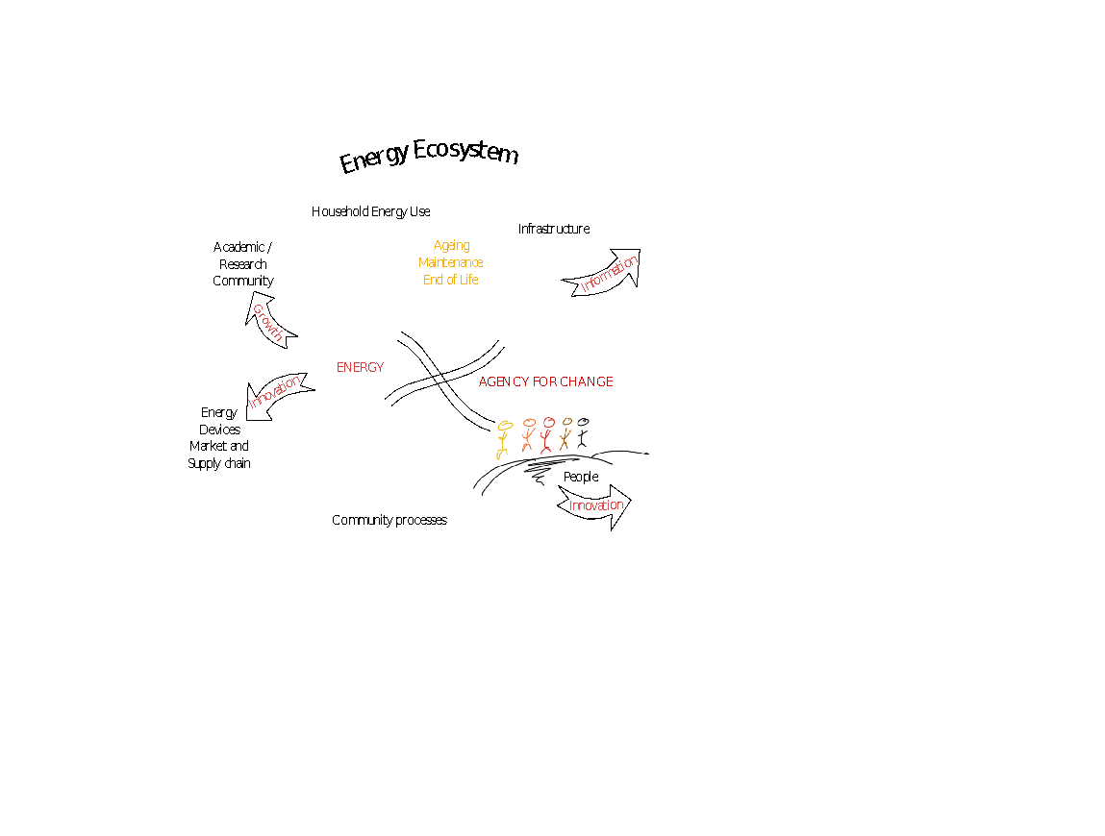
Human Challenges: Energy for Refugees

Slide 8
Explore and exploit the role of IoT technologies as
Enablers of understanding: social behaviour, energy usage patterns, reaction to energy exposure
Life long integrated component in distributed off grid energy systems – enabling novel financial models, end of life processes for the energy solutions, on-demand maintenance
Production of new research methodologies in the energy arena: integrative evidence based approaches to social phenome study

Slide 9
Some definitions
Internet of Things (IOT): equipping all physical and organic things in the world with identifying intelligent devices allowing the near real-time collecting and sharing of data between machines and humans. The IOT era has already begun, albeit in it's first primitive stage.
Data Science: the analysis of data creation. May involve machine learning, algorithm design, computer science, modeling, statistics, analytics, math, artificial intelligence and business strategy.
Big Data: the collection, storage, analysis and distribution/access of large data sets. Usually includes data sets with sizes beyond the ability of standard software tools to capture, curate, manage, and process the data within a tolerable elapsed time.

Slide 10
Delivery of: …a healthier world, cheaper ….a connected world, faster …safer workplaces …safer living …safer transportation a safe, healthy, efficient, knowledgeable and more connected world

Slide 11
Where and when did the IoT start? (open question – answers elicited!)

Slide 12
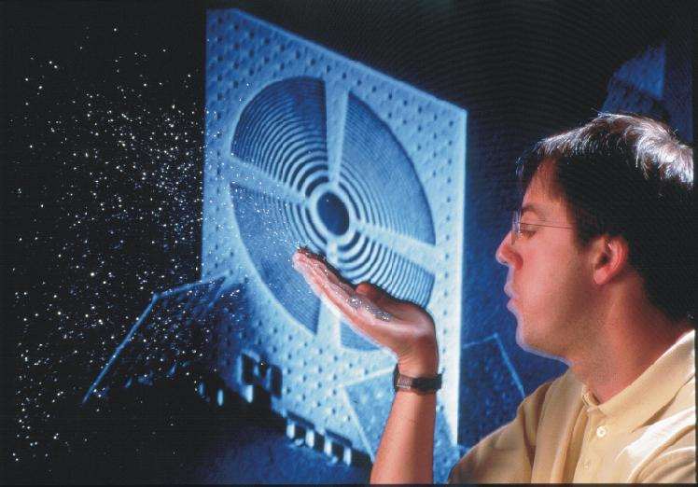

Slide 13
Smart Dust – early 90’s http://robotics.eecs.berkeley.edu/~pister/SmartDust/BlowDust.jpg

Slide 14
Smart Dust in a nutshell
Smart Dust promoted the idea of:
Wireless nodes that are:
small,
low-power and
disposable
Networks that are
massively scalable,
intelligent and
self-configuring

Slide 15
Application example - Quiz

Slide 16
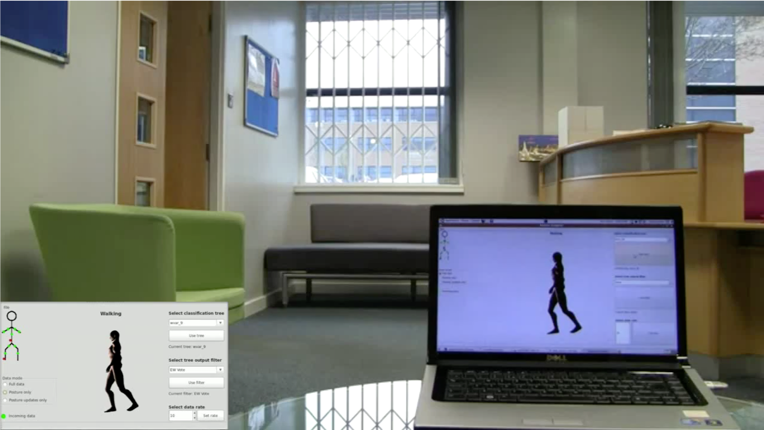

Slide 17
Mars video

Slide 18
The technology that enabled the IoT

Slide 19
https://www.youtube.com/watch?v=GiG5czNvV4A

Slide 20
What are the most common MEMS sensors that we most likely all wear? (open question)

Slide 21
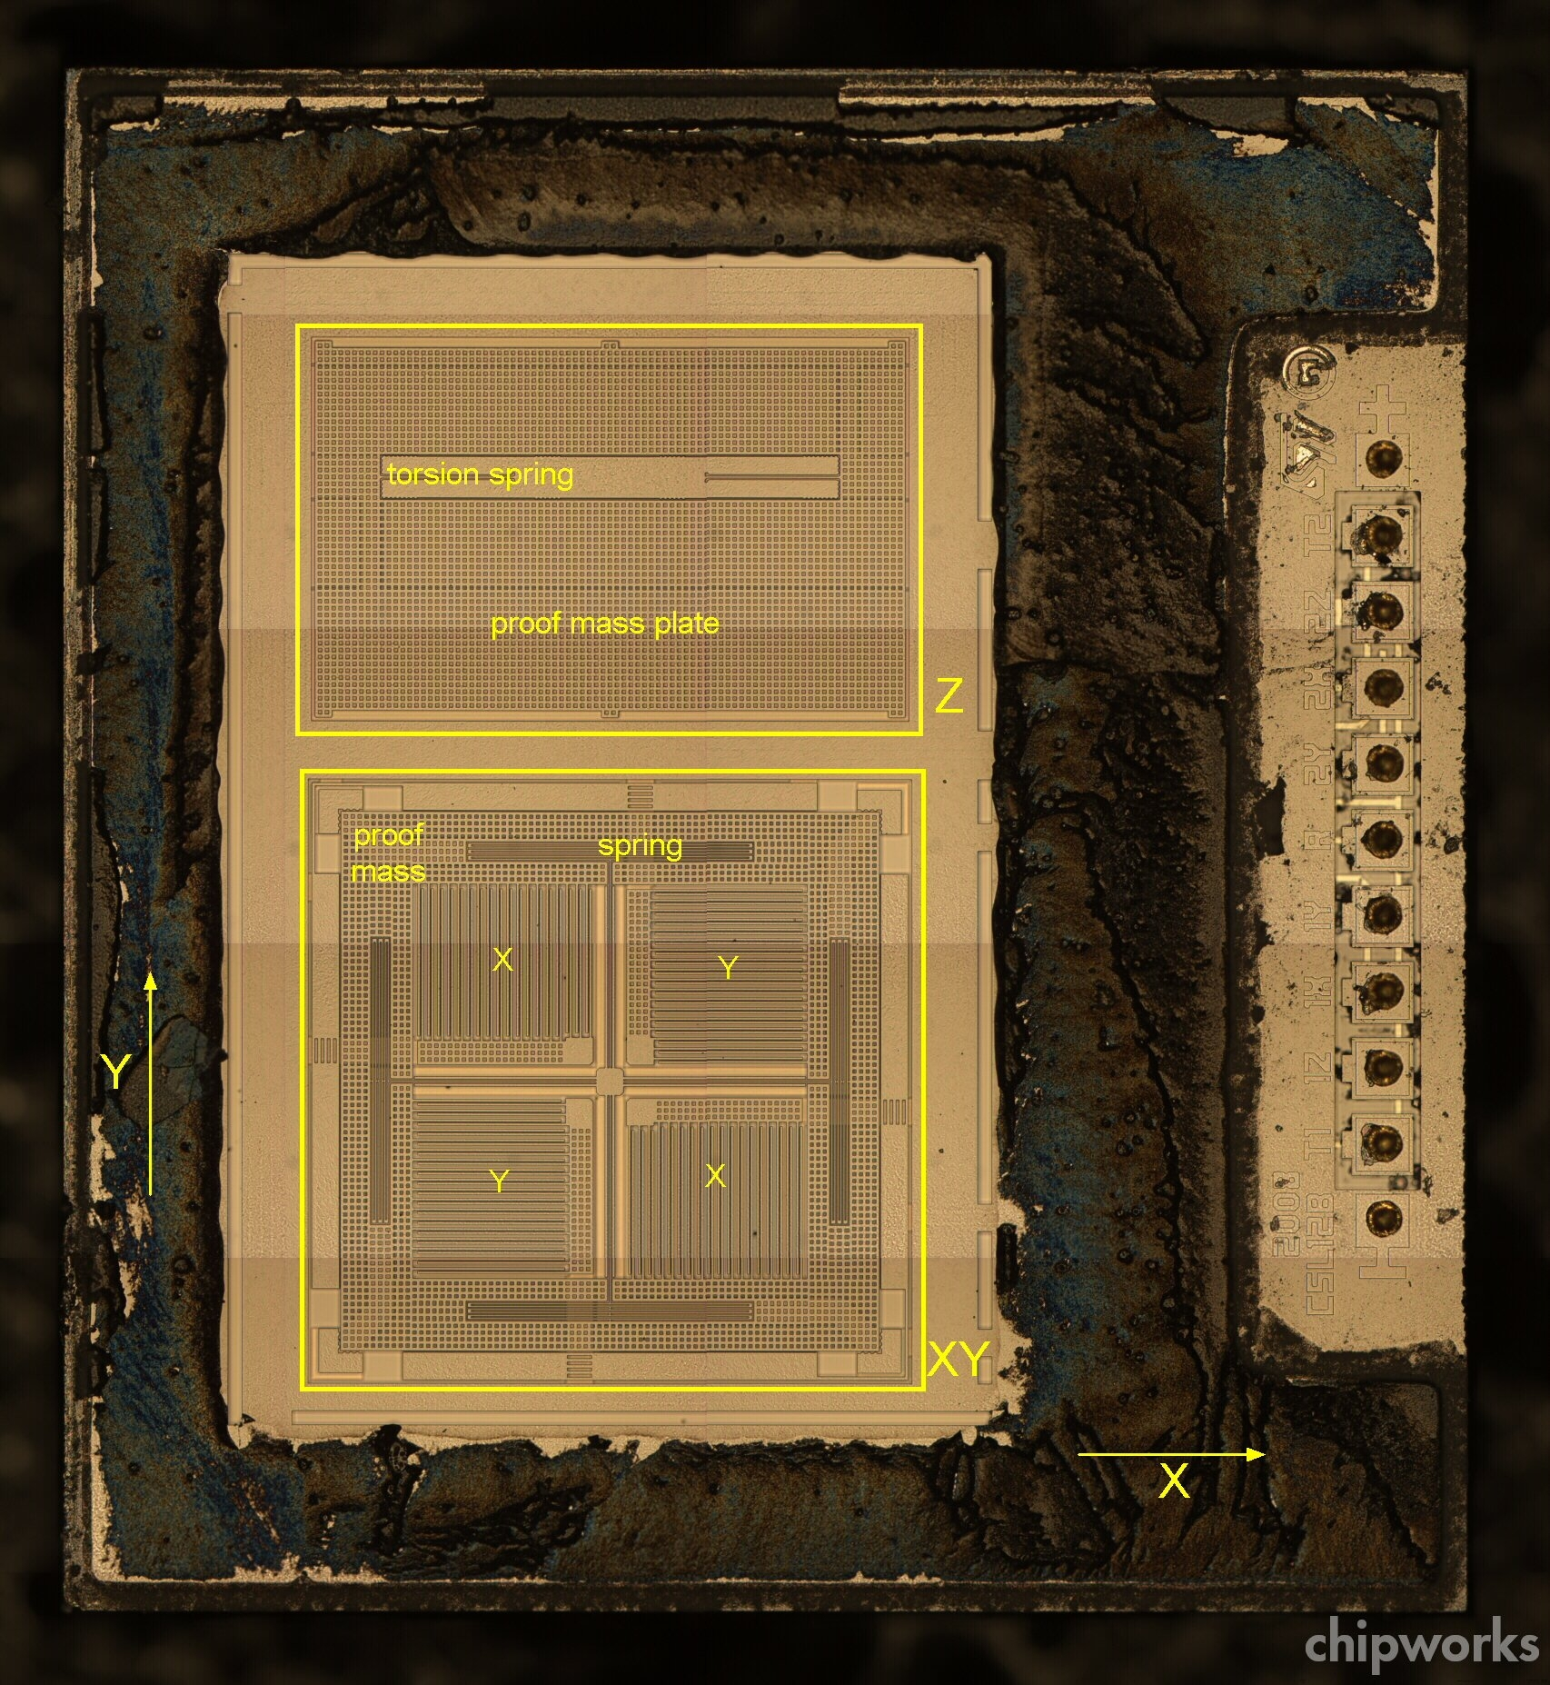
http://www.memsjournal.com/2010/12/motion-sensing-in-the-iphone-4-mems-accelerometer.html
And home made stuff:
https://www.youtube.com/watch?v=twI5j1u918M

Slide 22
Gyroscopes and applications https://www.slideshare.net/ankushwawoo/mems-gyroscope-working
http://www.geekmomprojects.com/geekmomprojects-wp/wp-content/uploads/2013/03/mems_gyroscope.jpg

Slide 23
What other useful sensors do you know of?

Slide 24
What does a sensor do?
Measure = provide data
What does a remote sensor need to provide us with data at a different location?
Electronic interface (transforms signals from the mechanical domain for example to the electrical domain) – generally provide analogue signals
AD Converter for the signals
Radio – to transmit the digitized data
Processor to take case of operations sequencing, sampling commands, read/write, etc
--- and what is needed at the receiver end?
How does a network of sensors look like and what can it do for us?

Slide 25
Going to Mars with IoT systems

Slide 26
We are in the pre-industrial age of data technology and science used to process and understand data. Yet the early evidence provides hope that we can manage and extract knowledge and wisdom from this data to improve life, business and public services at many levels.
To date, the internet has mostly connected people to information, people to people, and people to business. In the near future, the internet will provide organizations with unprecedented data. The IOT will create an open, global network that connects people, data and machines
Billions of machines, products and things from the physical and organic world will merge with the digital world allowing near real-time connectivity and analysis. Machines and products (and every physical and organic thing) embedded with sensors and software - connected to other machines, networked systems, and to humans - allows us to cheaply and automatically collect and share data, analyze it and find valuable meaning. Machines and products in the future will have the intelligence to deliver the right information to the right people (or other intelligent machines and networks), any time, to any device. When smart machines and products can communicate, they help us and other machines understand so we can make better decisions, act fast, save time and money, and improve products and services
The IOT, Data Science and Big Data will combine to create a revolution in the way organizations use technology and processes to collect, store, analyze and distribute any and all data required to operate optimally, improve products and services, save money and increase revenues. Simply put, welcome to the new information age, where we have the potential to radically improve human life (or create a dystopia - a subject for another time).
The IOT will produce gigantic amounts of data. Yet data alone is useless - it needs to be interpreted and turned into information. However, most information has limited value - it needs to be analyzed and turned into knowledge. Knowledge may have varying degrees of value - but it needs specialized manipulation to transform into valuable, actionable insights. Valuable, actionable knowledge has great value for specific domains and actions - yet requires sophisticated, specialized expertise to be transformed into multi-domain, cross-functional wisdom for game changing strategies and durable competitive advantage.
Big data may provide the operating system and special tools to get actionable value out of data, but the soul of the data, the knowledge and wisdom, is the bailiwick of the data scientist.

Slide 27
Exploration: from one sensor to Wireless Sensor Networks
Single Data Streams– work on increased data quality/accuracy – with AI tools
Many data streams – communications, technology, real-life – from Device to Applications
Making sense of data – Machine Learning applications
My data and the Internet of Things – large scale applications
Mining at the edges of the Internet of Things

Slide 28
Value is created by making sense of data
More Important
Wisdom
Evaluated understanding
Understanding
Appreciation of WHY
Benefits to Humanity
Knowledge
Answers to HOW questions
Information
Answers to WHO, WHAT, WHERE and WHEN questions
Less Important
Data
Symbols

Slide 29
Focus: data handling technology systems
VISION
Values
WISDOM
Goal
KNOWLEDGE
Model
INFORMATION
Rules
DATA Index
Data-handling technology
allows human cognitive energy
to shift upward.
Without technology,
cognitive allocation
mires in low-layer processes.
Data-handling
technology
system
∞
∞
ENVIRONMENT
http://www.cognitivecybernetics.com/PrimerFoU_files/image004.jpg

Slide 30

Evolution (of terms and technology)
Wireless sensor networks
Ubiquitous computing
Internet of things
Machine to Machine
https://itunews.itu.int/en/4291-The-Internet-of-things-Machines-businesses-people-everything-.note.aspx

Slide 31
Data to knowledge: research cycles
Sense-and-send system design/prototype/development
Understand phenomena; uncover technical challenges towards deployable systems/robust solutions
Negotiate informational needs with application specialists
Beyond sense-and-send: innovate in application-specific key issues; iterative prototyping; build in real-time information extraction/processing
Beyond sense-and-send: system of systems; actuation; decision making; knowledge generation; produce knowledge driven designs

Slide 32
Scaling up: from a handful to 37 billion new things in the Internet of Everything Biological and machine learning models to deal with complexity

Slide 33
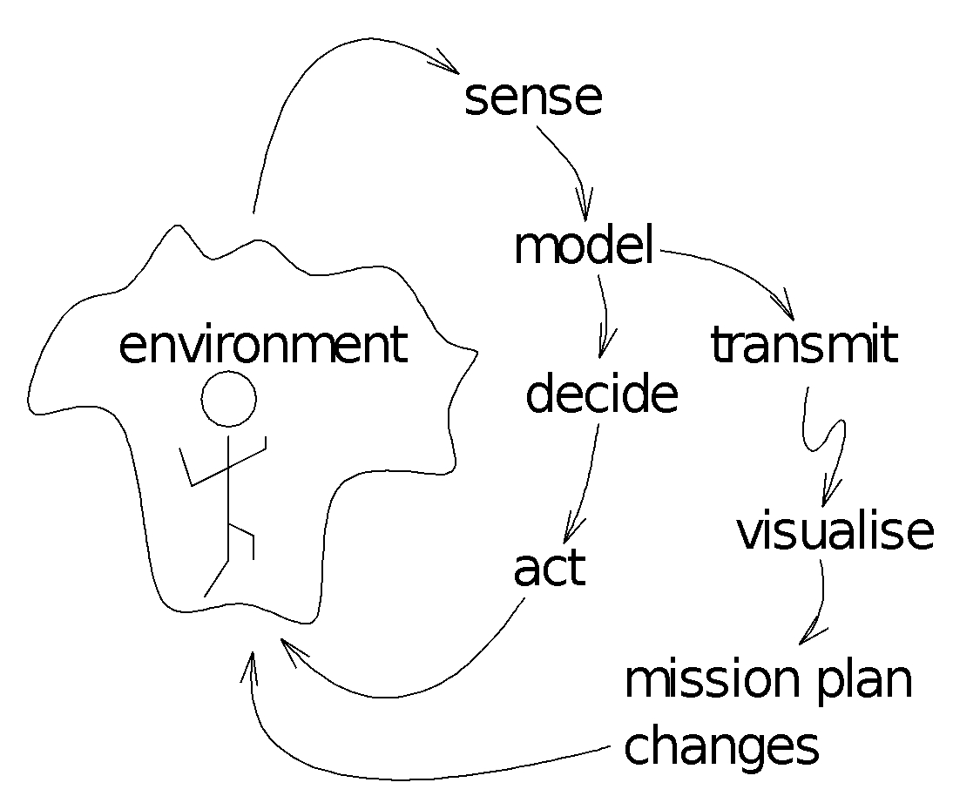
Common core conceptual approach for IoT applications
Instrument, Understand, Model, Predict, Actuate/Automate
Look at the wider picture; think future proofing

Slide 34
Building IoT/WSN applications

Slide 35
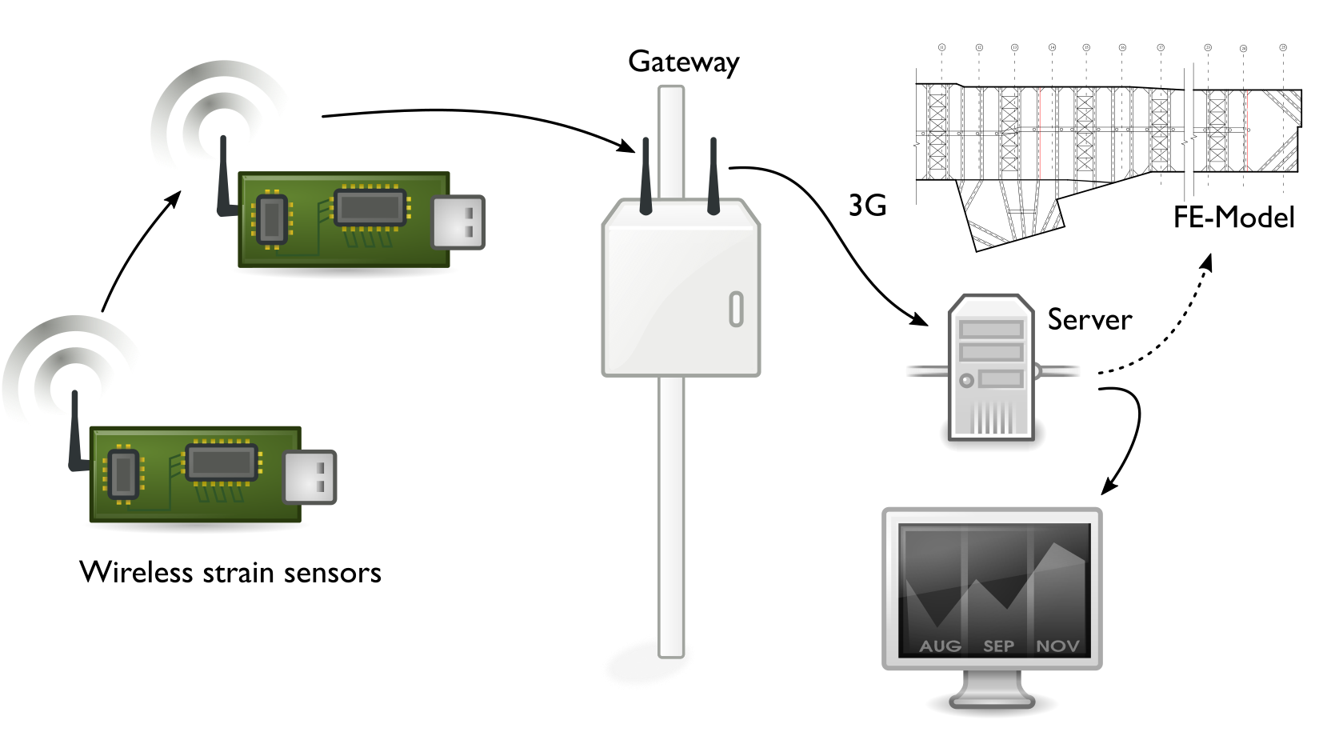
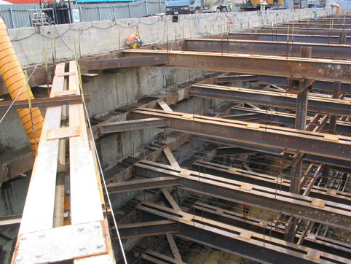
Example Sensor Network Design for an IoT temporary support structure (construction)

Slide 36
Design decisions
Use off the shelf as much as possible
Very short development timespan for prototype
Hardware
Sensor node – Telos-like Z1, with custom board
Gateway – Raspberry Pi
Software
WSN: off the shelf OS, MAC, Multi-hop protocol
Gateway: python for rapid development
Packaging
Standard-sized IP65 aluminum cases
Sensors
1 x weldable resistive strain gauge
Notes:
Given the very short development time for the project, we focused on taking as much hardware, software and mechanical parts off the shelf as possible for both sensor node and gateway. Our strain sensing task was simplified somewhat due to the assumption of axial strain on the struts we were monitoring. This meant only one strain input was required.
The customized equipment made for this project was:
Strain sensor PCB
Modified enclosure to house sensor node
Enclosure to house gateway and batteries
Application software for sensor nodes, sink, gateway and web interfaces

Slide 37
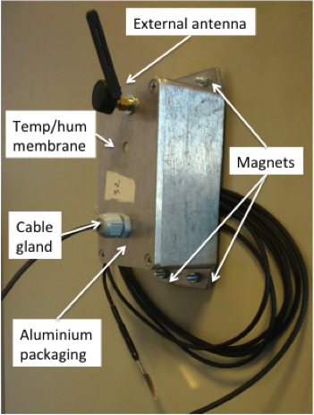
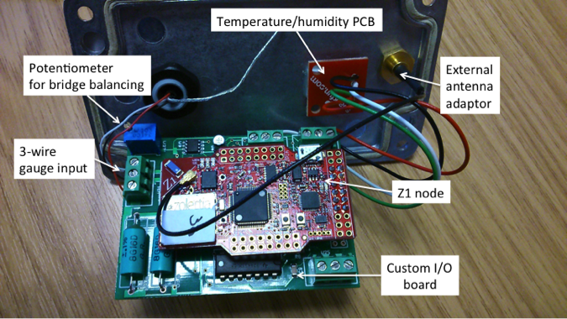

Slide 38
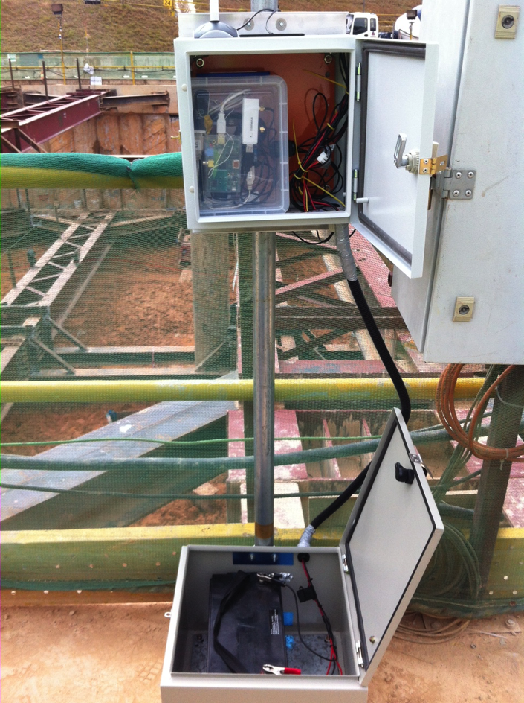
Local Gateway
Notes:
Raspberry Pi model A
TelosB node
Wifi for on-site access
Used during installation
3G for remote Tx
Hourly updates of measurements
Local storage
32GB SD card
Estimated lifetime 34d
100Ah battery

Slide 39
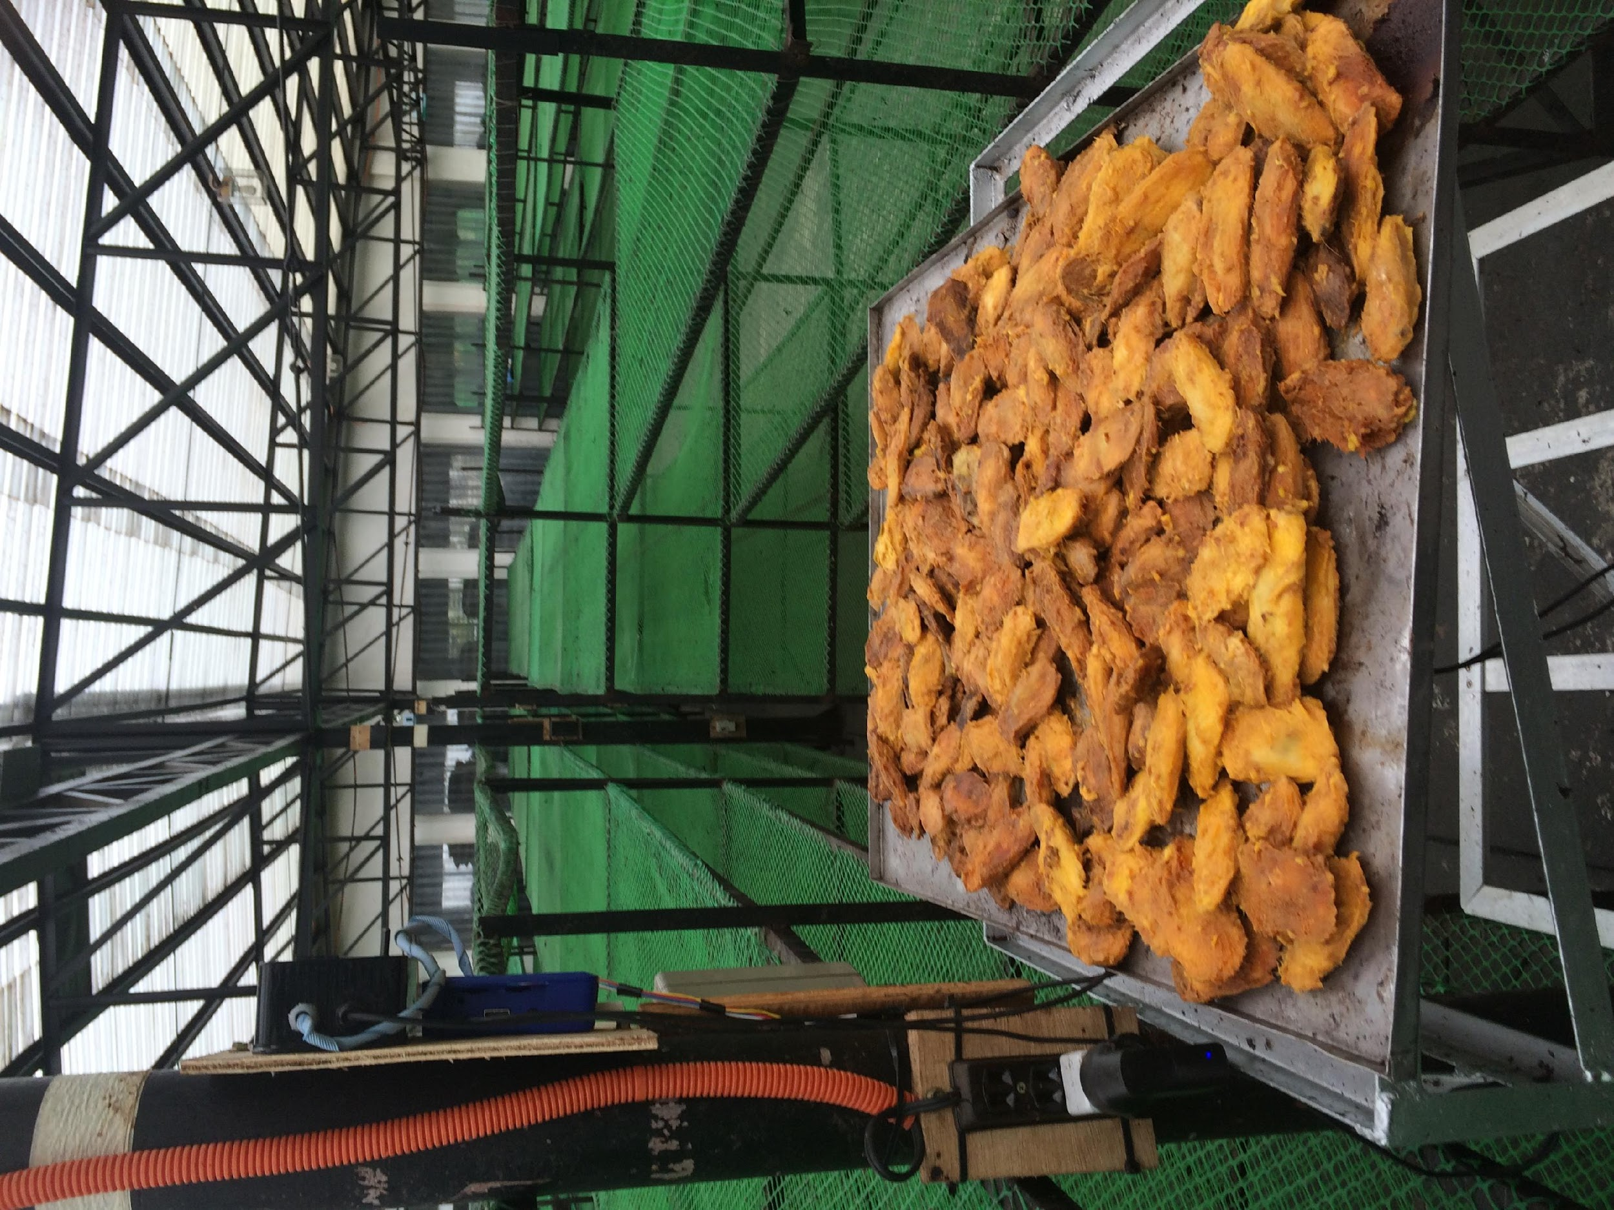
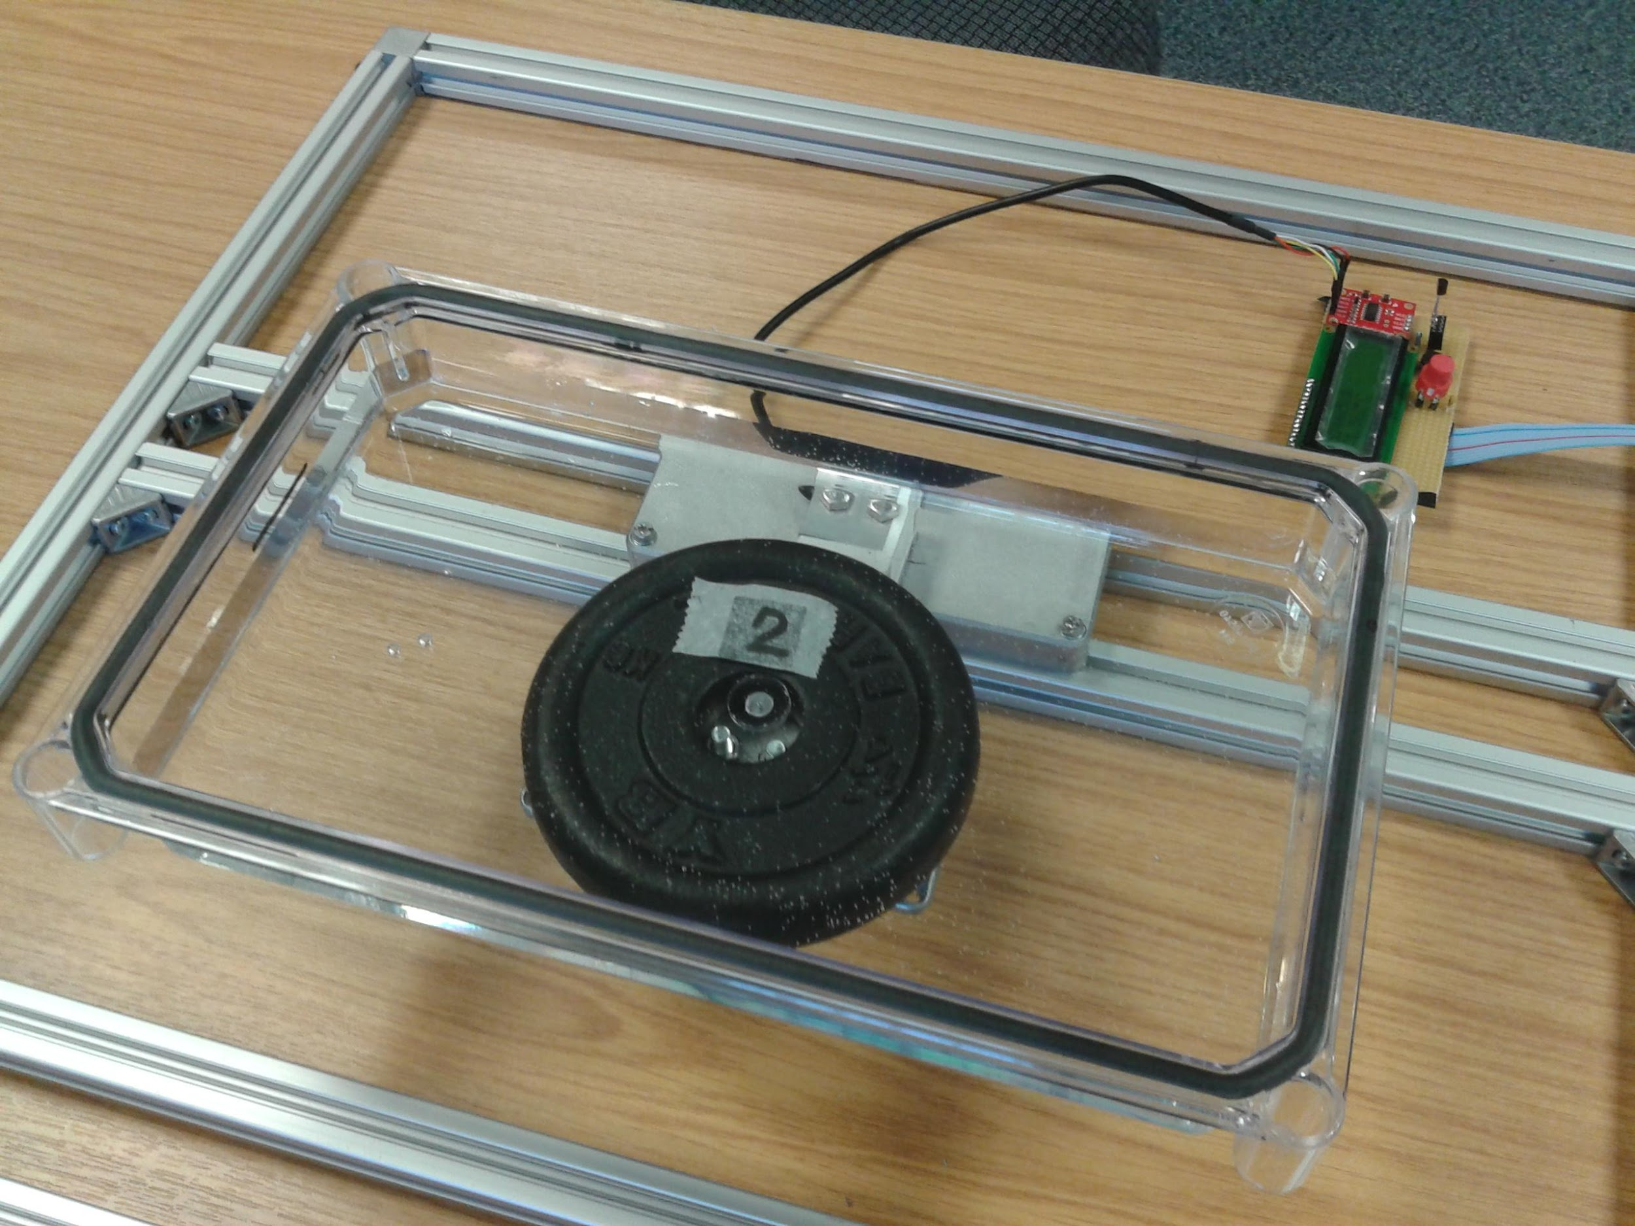
PULP: Wireless Scale
IoT shelves – drying prediction and factory automations – Factory 4.0

Slide 40
PULP: Wireless Scale
Features:
Internet enabled scale
Mango waste drying process
Sensing: Temperature & Weight
Sample period 0.5Hz
Remote data transfer (Philippines to Coventry)-–once per hour
5 scales deployed in the field for two years
Led to innovative drying model
Costs:
RaspberryPi+Peripherals £60
Load Cell £7
Temperature sensor £5
Circuitry £5
Enclosure £10
Total £95
Notes:
Key charactristics
Costs

Slide 41
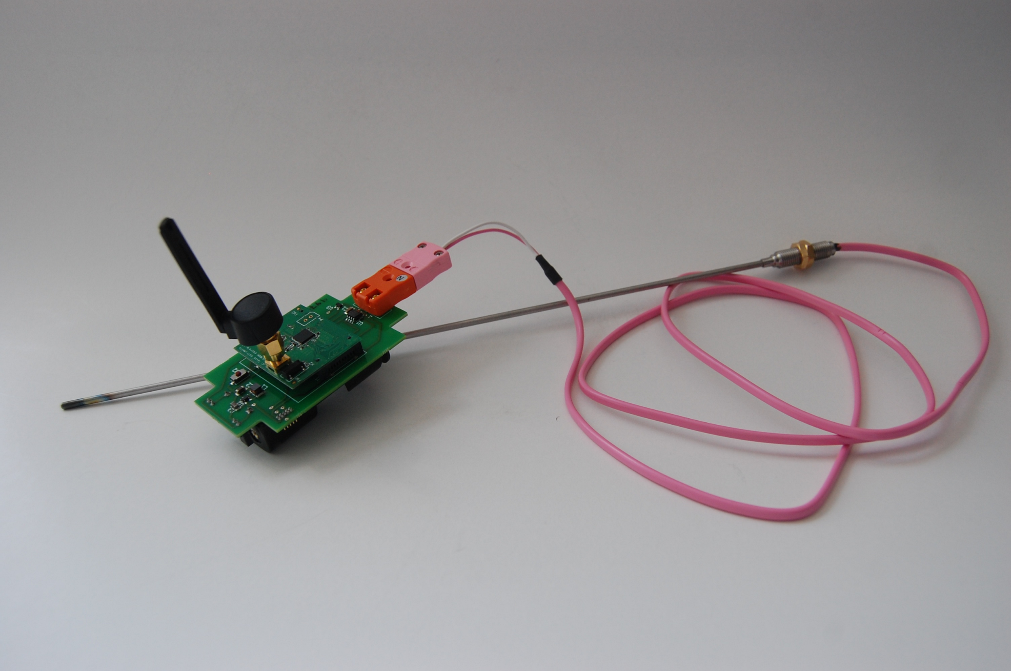
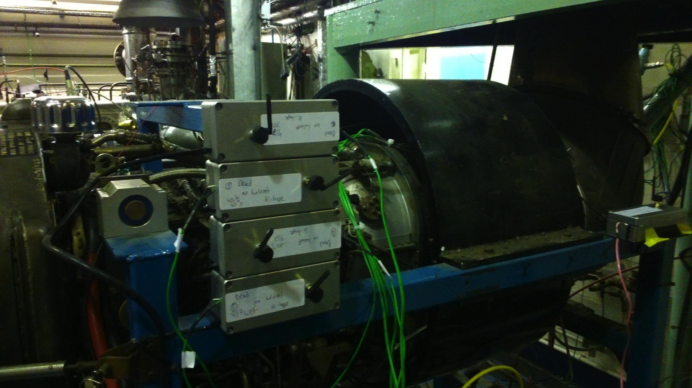
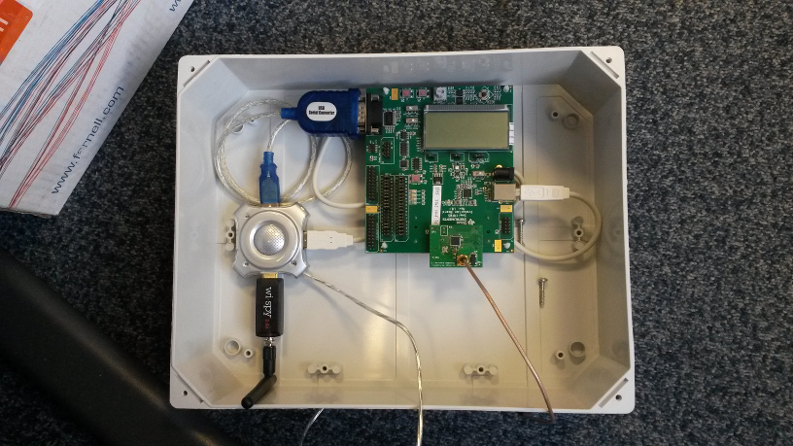
Thermocouple sensing
Notes:
Key charactristics
Costs

Slide 42
Features:
Originally designed to measure temperature in Jet Engines
Thermocouple can measure extreme temperatures 1000℃+
Costs:
Thermocouples £20
Firefly £40
Thermocouple sensing
Notes:
Key charactristics
Costs

Slide 43
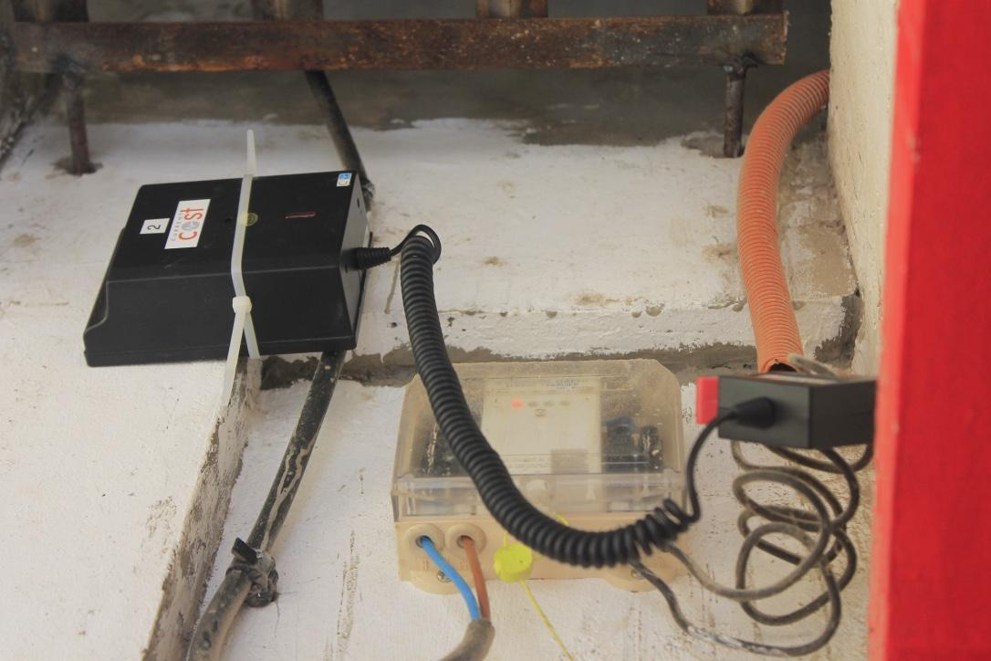
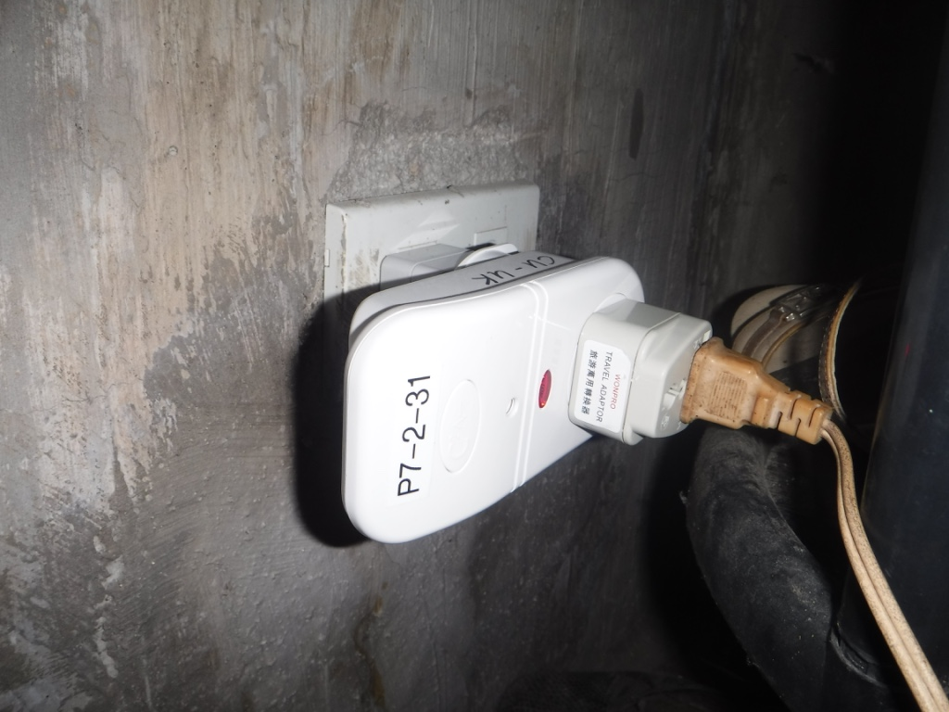
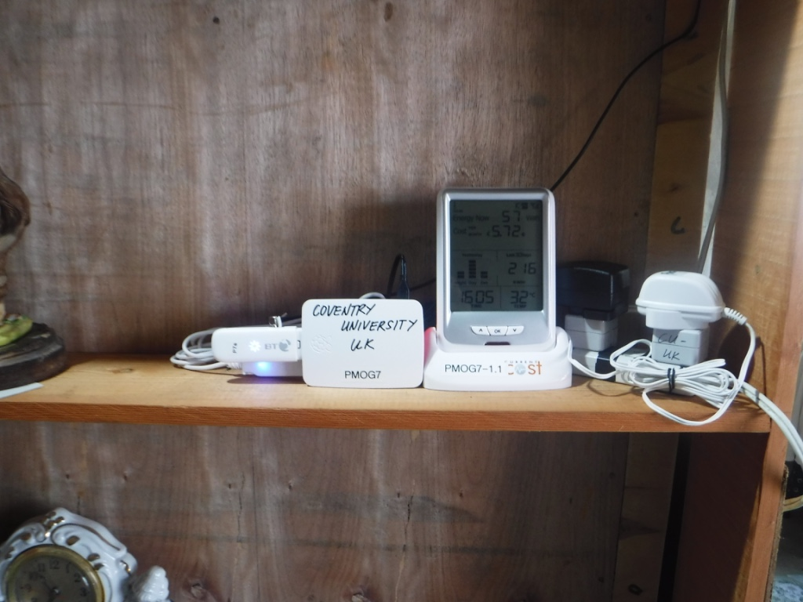
Electricity sensing
Notes:
Key charactristics
Costs

Slide 44
Features:
Measures electricity at appliance and home level every 6 seconds
Current cost is an off-the-shelf system
10 systems deployed in 2 remote Philippines Islands
Data transmission every hour via 3G to CU
Same underlying architecture as the Scale sensor
Demo: Local data acquisition of data from a fan. System running live in the Philippines.
http://cogentee.coventry.ac.uk/PMOG/
Costs:
Current Cost EnviR (Clamp+ Display) £25
Appliance monitor £15
Electricity sensing
Notes:
Key charactristics
Costs

Slide 45
Features:
Our flagship sensing device
Developed all architecture+ learning from here
Based on the TelosB hardware platform (temperature, humidity, and light on board sensors)
Sensing modalities: Temperature, Humidity, Light, CO2, Electricity, Gas, Air Quality etc.
Lifetime 5years+
Over 200 deployments
Longest deployment 3 years
Demo: Multiple node data acquisition + live system
Costs:
TelosB board £60
Sensors vary from £5--£50
Raspberry pi server £70
Home Monitoring System
Notes:
Key charactristics
Costs

Slide 46
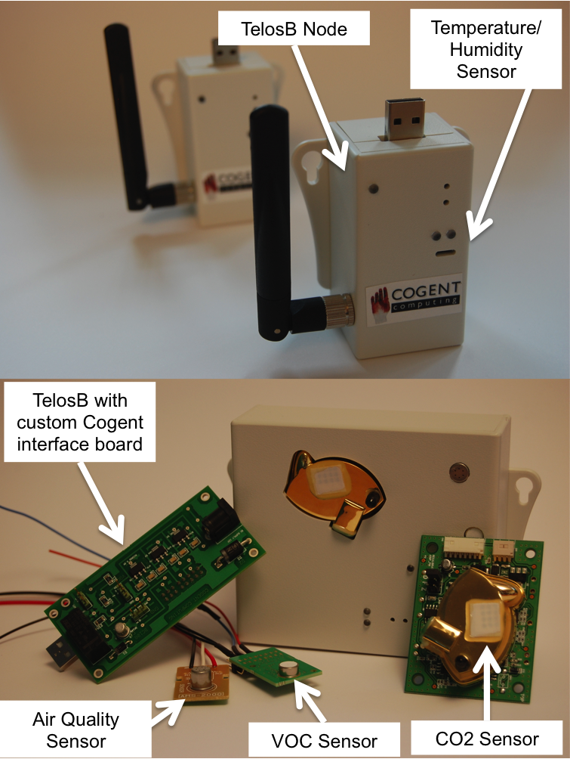
Home monitoring system cogentee.coventry.ac.uk/ch-silicon

Slide 47
Features:
Accelerometer measures movement in respect to gravity
Currently being used in an earthquake structural assessment project
Will be applied to the solar lanterns
Challenge: Low power sensing, knowing where the lantern is
Demo: Show the detection of movement and the importance of edge mining
Costs:
Firefly board £40
Accelerometer £6
Temperature £6
Movement monitoring
Insert MOVIE - kemp
Notes:
Key charactristics
Costs

Slide 48
Challenges
Environment
End-Users and application specialists: Human in the loop
Data – too little or too much
Decisions – timeline/timeframe
Utility & Usability – integrations with processes and business models
Future proofing & Scaling up
Development time for filed systems
Exploitation vs Exploration

Slide 49
Example (exploitation) – ReStructure: applying wireless sensing capabilities to TERS monitoring
Singapore
MIT-SMART funded

Slide 50
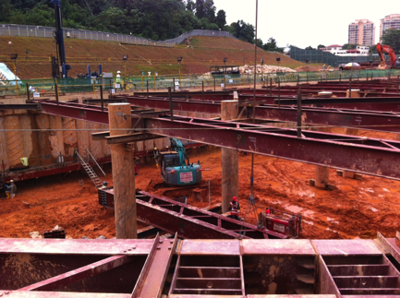
Temporary Earth Restraining Structures
TERS used during excavations
Designs based on model analyses
Monitored throughout construction
Cost limits scope of measurements
Thresholds: performance OK below pre-set levels
Safe: but little motivation to reduce spiralling costs
Measurements could be used in dynamic models
Updated during construction to reflect observations
Improve knowledge, reduce risk => reduce costs
Purpose: increase density and value
of measurements during excavations
Notes:
Temporary Earth Restraining Structures are used during excavations, and their designs are based on model analyses carried out before the excavation. In our case, the excavations pertain to MRT/underground tube stations.
The performance of the TERS is monitored throughout construction with field measurements (strain, load, pore pressure, wall deflection).
The measurements are used for two purposes:
To compare against the expected values given by the model
To determine if certain parameters have gone beyond design spec (for example, wall deflection), in a traffic-light scenario
Measurements are expensive to take and not always automated. This means that while safety can be ensured, the overall costs of construction keep increasing.
In addition, it is not general practice to incorporate field measurements into models during construction. However, if this could be enabled, knowledge about the network could be improved, which could in turn reduce risk and overall costs in the future.
This project aims to address these problems.
One goal of this project is to apply wireless sensing capabilities to TERS monitoring, to enable cheap measurements to be taken at a high density, ideally for the same cost or less than is currently needed for monitoring.

Slide 51
ReStructure: applying wireless sensing capabilities to TERS monitoring
Goals
Achievements over 18 months
Goal 1: Field-deployable WSN prototypes
Reliable, valid structural measurements (strain)
Reliable network communication
Deployment and weatherproofing experience
Goal 2: Move toward intelligent WSNs
Raw data collection => intelligent operation
Improve network lifetime, increase value of data
Testing: REAL deployments during excavation
MRT/underground tube stations
2014: Designed & tested prototype WSN
12 months for full prototype (8x + gateway)
Hardware (PCB, packaging) and Software
(2 revisions of packaging)
2015: Field tests for long term measurement
Jan - Jun: 3 x 1-hop deployments + multi-hop testing
1. Feb 11th - Apr 18th (66 days +), 2 nodes
2. May 5th – on (>31 days), 2 nodes
3. June 9th – on (>3 week), 2 nodes
Notes:
In applying wireless sensing to TERS monitoring, we want to increase the density of measurements, and with this increased density of measurements also increase the value of these measurements to the overall construction (i.e. enabling data to feed into real time models, not just inform static alarm thresholds)
The cheapest measurement that can be made of the TERS is strain, used as a proxy for load on the structure. So we are aiming to create a WSN to be deployed directly on the support struts to take strain data.
This network will act as a proof-of-concept for the project, enabling measurements that could be fed into a real-time model, as well as being a tool to collect a high resolution archive of strain data throughout a construction project.
Achieving a feasible prototype requires valid measurements, reliable wireless communication as well as packaging for protection against the weather.
Analysis of the archive of data that is created through this pilot will give insight into the feasibility of moving toward intelligent WSNs for TERS monitoring, where network lifetime can be extended, for example.

Slide 52
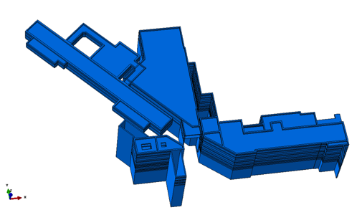

Example: Prototype Sensor Network Design Goals
Static strain measurement
Deploy node on strut next to gauge
Wireless transmission of data
Target 1 year lifetime (or length of construction)
15 minute sampling interval (sense and send)
Integration with model predictions
Wireless multi-hop network
3G phone network
1. Strain and repeater nodes
(deployed on struts at excavation site)
2. Gateway (surface at excavation)
3. Remote server
4. Application/model
Notes:
The prototype network has several goals:
Strain measurements to be made on-strut
Data to be transmitted over wireless at 15 min intervals, to target a 1 year lifetime (or the length of the construction)
The data be able to integrate into a TERS model
The diagram shows the basic network architecture, where data flows from the network to a sink, where it is transmitted to a remote server via 3g and subsequently made available to suitable applications (such as a graphical user interface, or a model)

Slide 53
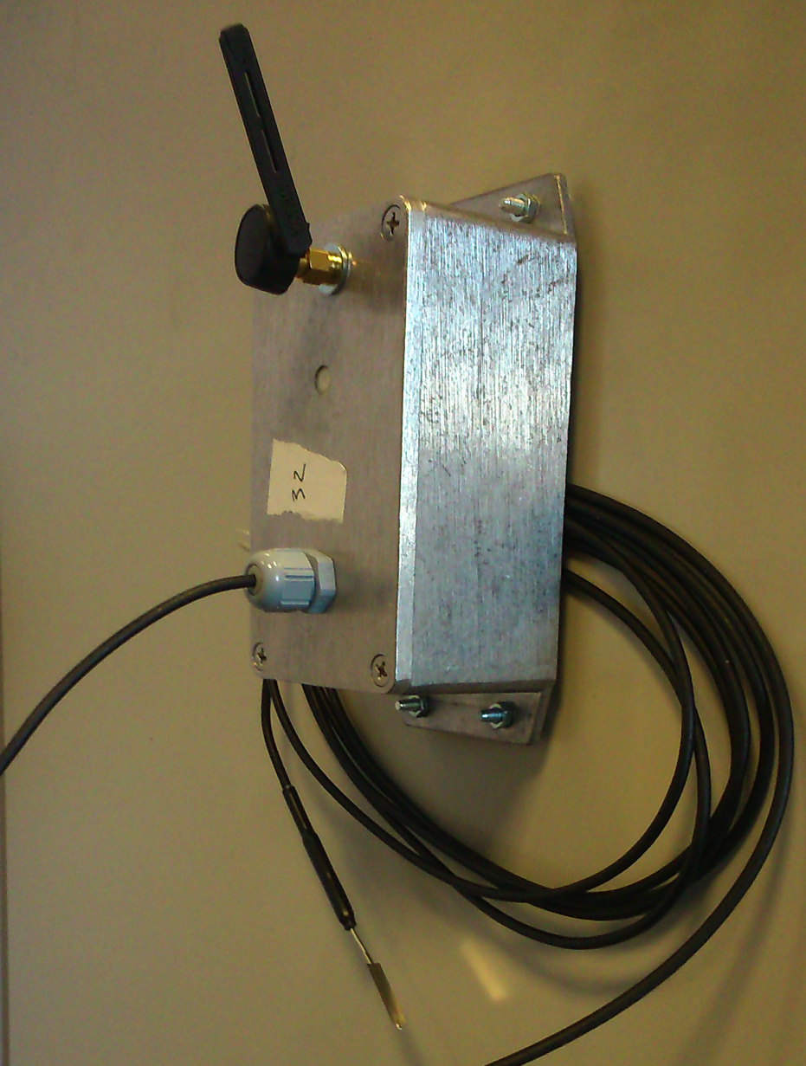
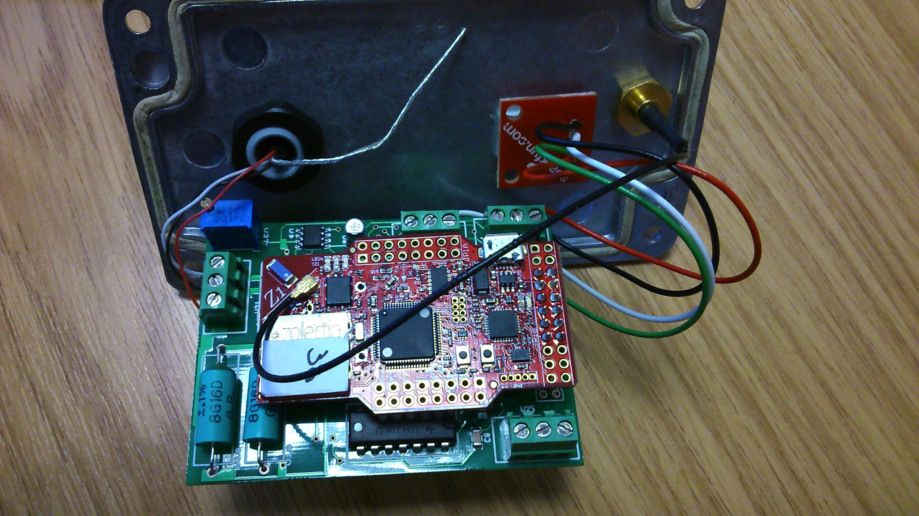
Wireless Sensor Node Design
Custom sensor board
Strain: wheatstone bridge
16-bit i2c ADC (ADS1115)
Excitation: 3.3V
Reduce energy consumption: Half bridge: 10K resistors
Temp & RH: SHT15 (i2c)
Platform: Zolertia Z1
MCU: MSP430
16-bit, 16MHz, 8KB RAM
92kB prog. flash, 1Mbit serial flash
Radio: CC2420
2.4GHz 802.15.4 radio
MSP & CC2420: classic WSN
OS: Contiki
Temperature/humidity PCB
Potentiometer for bridge balancing
External antenna adaptor
3-wire
gauge input
Z1 node
Custom I/O
board
Notes:
We chose the Zolertia Z1 as our sensor node development platform. It is backwards compatible with the ubiquitous Telos platform, but includes larger amounts of program memory, and better access to hardware pins to interface our strain sensor board with. The platform is a combination of the MSP430 microcontroller and a 2.4GHz CC2420 802.15.4 radio, and supports an external antenna.
The Z1 supports both popular WSN operating systems, TinyOS and Contiki, out of the box.
Our custom PCB was developed to support a single wheatstone bridge in a quarter bridge configuration, which could be read by a low power 16-bit ADC. To save energy, we configured half of the bridge to use 10k resistors. The bridge can be balanced using a manual potentiometer (rather than the digital one present in the UIUC IMote2 strain board).
The low power ADC was connected to the Z1 via the i2c digital interface.
We also included inputs for a SHT15 digital temperature and humdity sensor that could be positioned away from the main board, into the node packaging, to allow external measurement.

Slide 54
Gateway & Enclosure
Raspberry Pi model A
Telos node
Wifi for on-site access
Used during installation
3G for remote Tx
Hourly updates of measurements
Local storage
32GB SD card
Estimated lifetime 34d
100Ah battery
Notes:
In designing the gateway, we chose an embedded linux platform that has good support for software and hardware – the raspberry pi fits these requirements well.
We chose the most low-power version of the raspberry pi, and wrote our software to minimise the amount of time that the radio and wifi would be used.
We added a USB wi-fi dongle for on site debugging: the pi runs a webserver and acts as a wif-fi access point, so a field technican can connect to the pi’s wi-fi network on-site, and look at up to date stats of incoming data in a web browser.
We added a USB 3g modem to allow data to be transmitted to our remote servers every hour.
A Telos node is used as a sink, to link the gateway to the sensor network – it pushes all packets received over the serial port.
Power to the USB connections are controlled by our software on the raspberry pi, meaning it can save power by only switching them on when they are needed.
As with the sensor nodes, data is always stored locally, meaning any network problems will not affect the final data sets.
In this set-up we chose to power solely by battery and through micro-benchmarking estimate that using a 100Ah battery, the lifetime of the device is just over one calendar month.
This level of lifetime is reasonable for battery replacement, but future solutions would likely use solar power to remove the need for frequent battery replacement

Slide 55
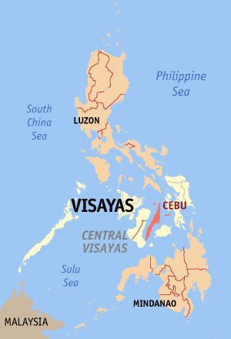
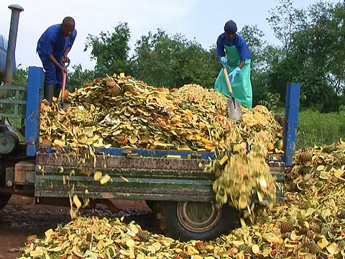
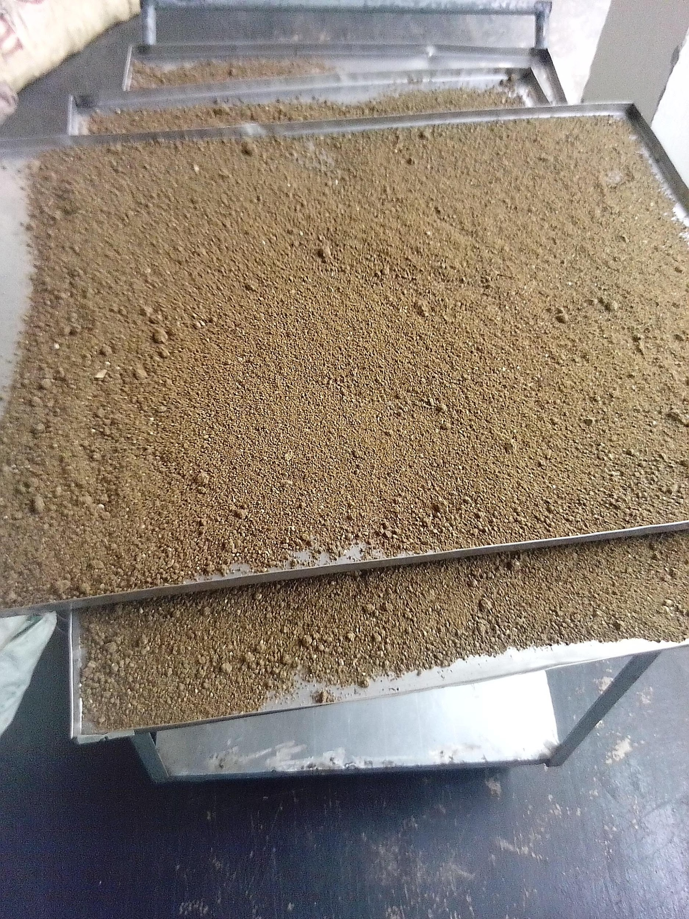
Example (exploration): PULP SEED Enable waste reduction and workers socio-economic development through technological breakthroughs

Slide 56
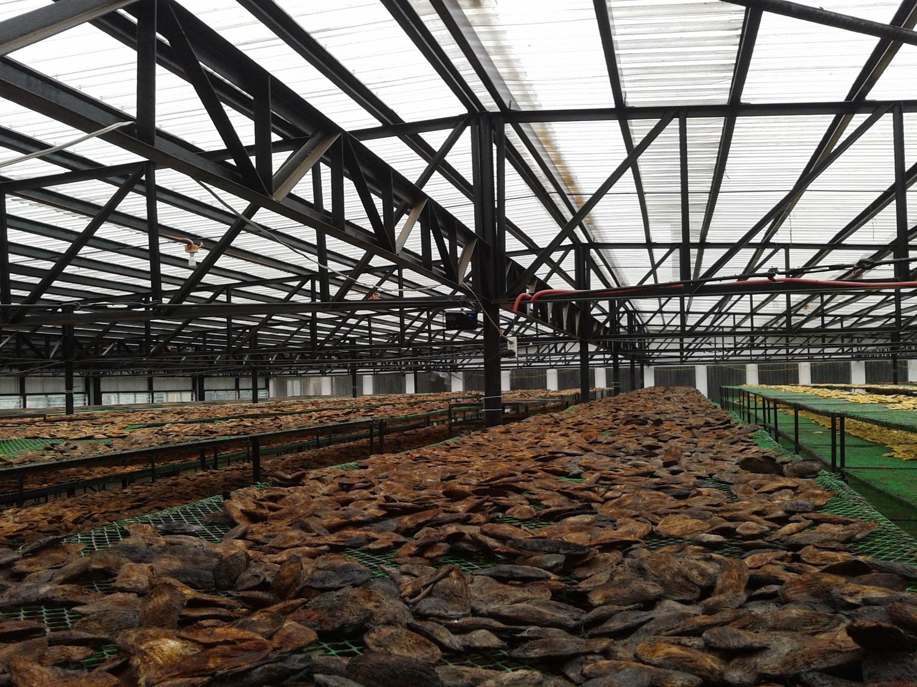
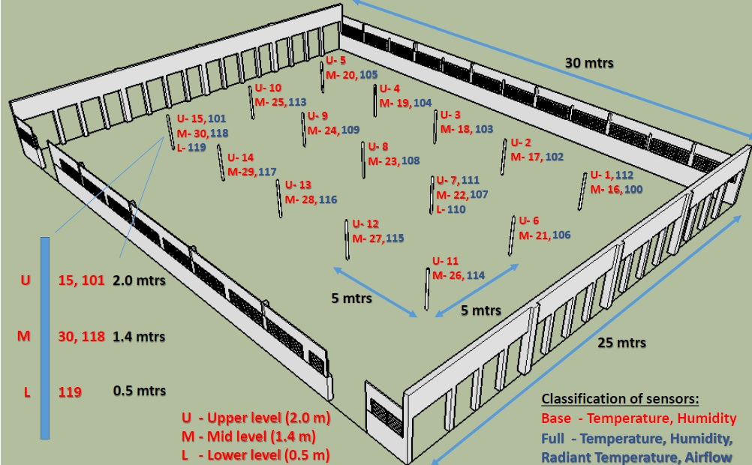
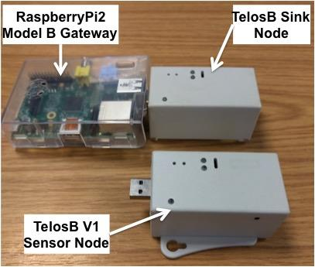
PULP-SEED

Slide 57
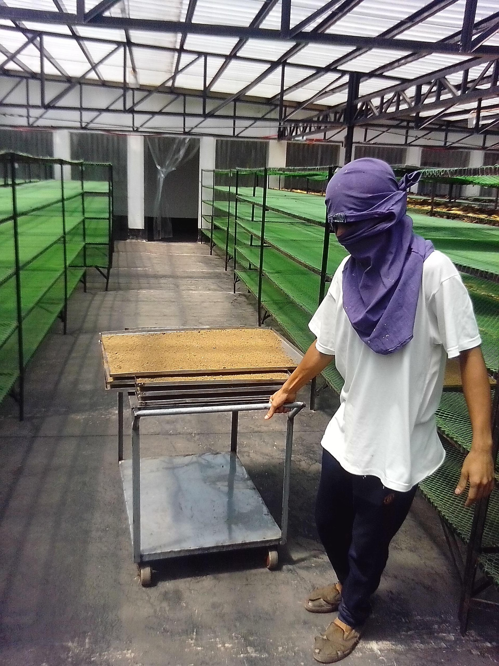
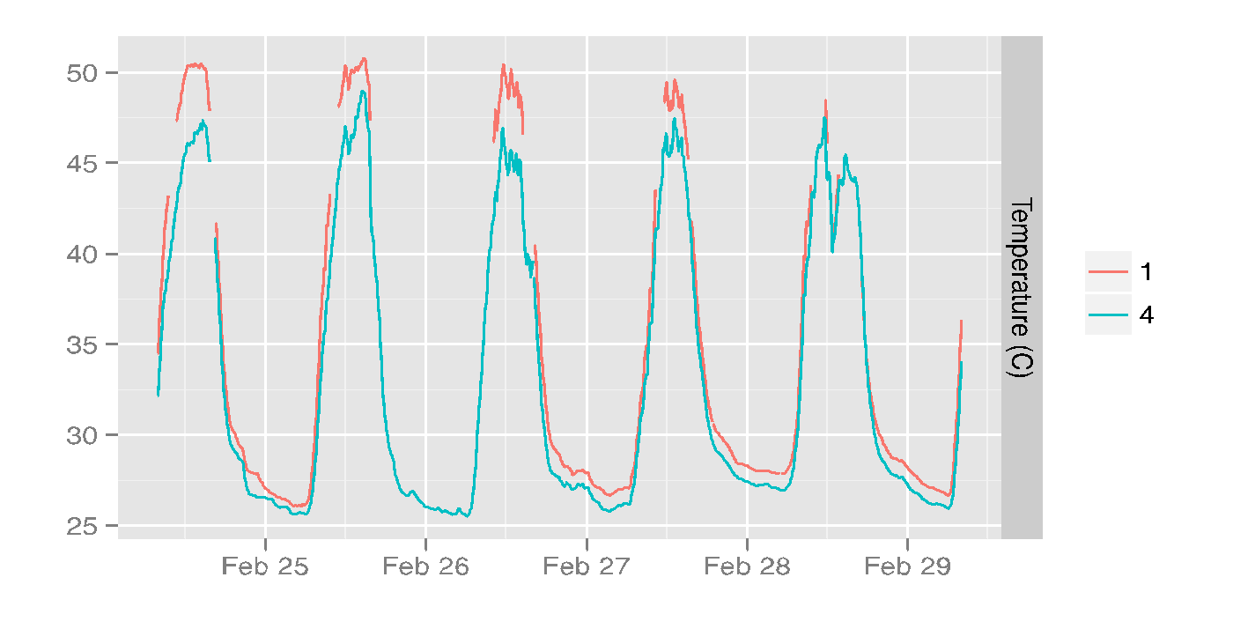
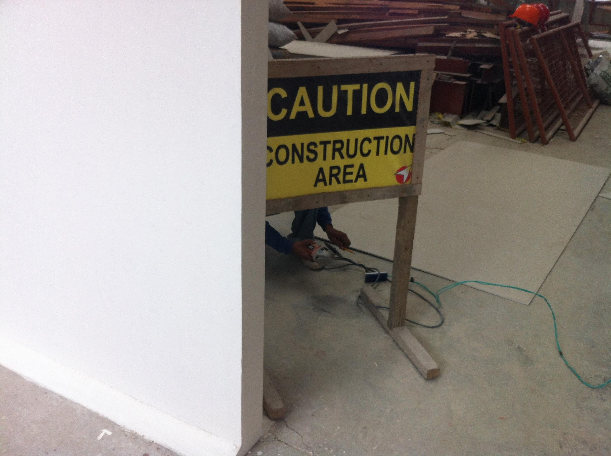
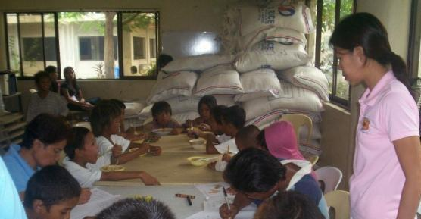
Expected social and economic impact: growth, employment & community, work conditions & upskilling
http://pulp.coventry.ac.uk/dashboard/

Slide 58
PULP: Wireless Scale
Single major achievement:
Enabling predictive mango drying (hw and sw)

Slide 59
IoT applications design- Group exercise + submission for prizes
In your group, you will need to specify an IoT application that would solve a relevant, real-world problem in Nepal (be it economical, societal or natural hazards related)
Your specification needs to be in written format and contain all of the elements below
Title
Motivation for your IoT application – needs that it would, meet, why an IoT solution, etc – max 100 words
Concept description – diagram or words – or both – sensors, networking, servers and their roles in the app
Users, beneficiaries and impact you think this application will have – 100 words
Sell-pitch – 100 words (why should anyone take it seriously - for funding, for example)
You have 60 min in clas and any amount of time tonight, as a group, to:
brainstorm
decide on application
Produce application level design – devices, communications, sensing, decision making, actuation, users, beneficiaries
formulate sell pitch – write-up + diagram, submit for prize
BUT you can continue during the evening….
Submit by MIDNIGHT Nepal time, on 29th March
If more than 3 applications submitted, we will select the best and award the prize tomorrow morning!

Slide 60
The HELP Project (nearly 1h) This lecture provides the background to the HELP project and demonstrates how IoT can help assess the impact of energy access on refugee and internally displaced communities.

Slide 61


Humanitarian Energy for Displaced Populations in Refugee Camps and informal Settings – HELP

Slide 62
HELP Project Summary
Title: Humanitarian Energy for Displaced Populations in Refugee Camps and informal Settings – HELP
Partners: Coventry University (CU), Oxford University (OxU), Practical Action (PA), Scene Connect (SC)
PI: Prof Elena Gaura (CU)
Project duration: 36 months (1st September 2017 until 31st August 2020)
Total project value: £1,114,390
Total ESPRC funding: £957,100

Slide 63
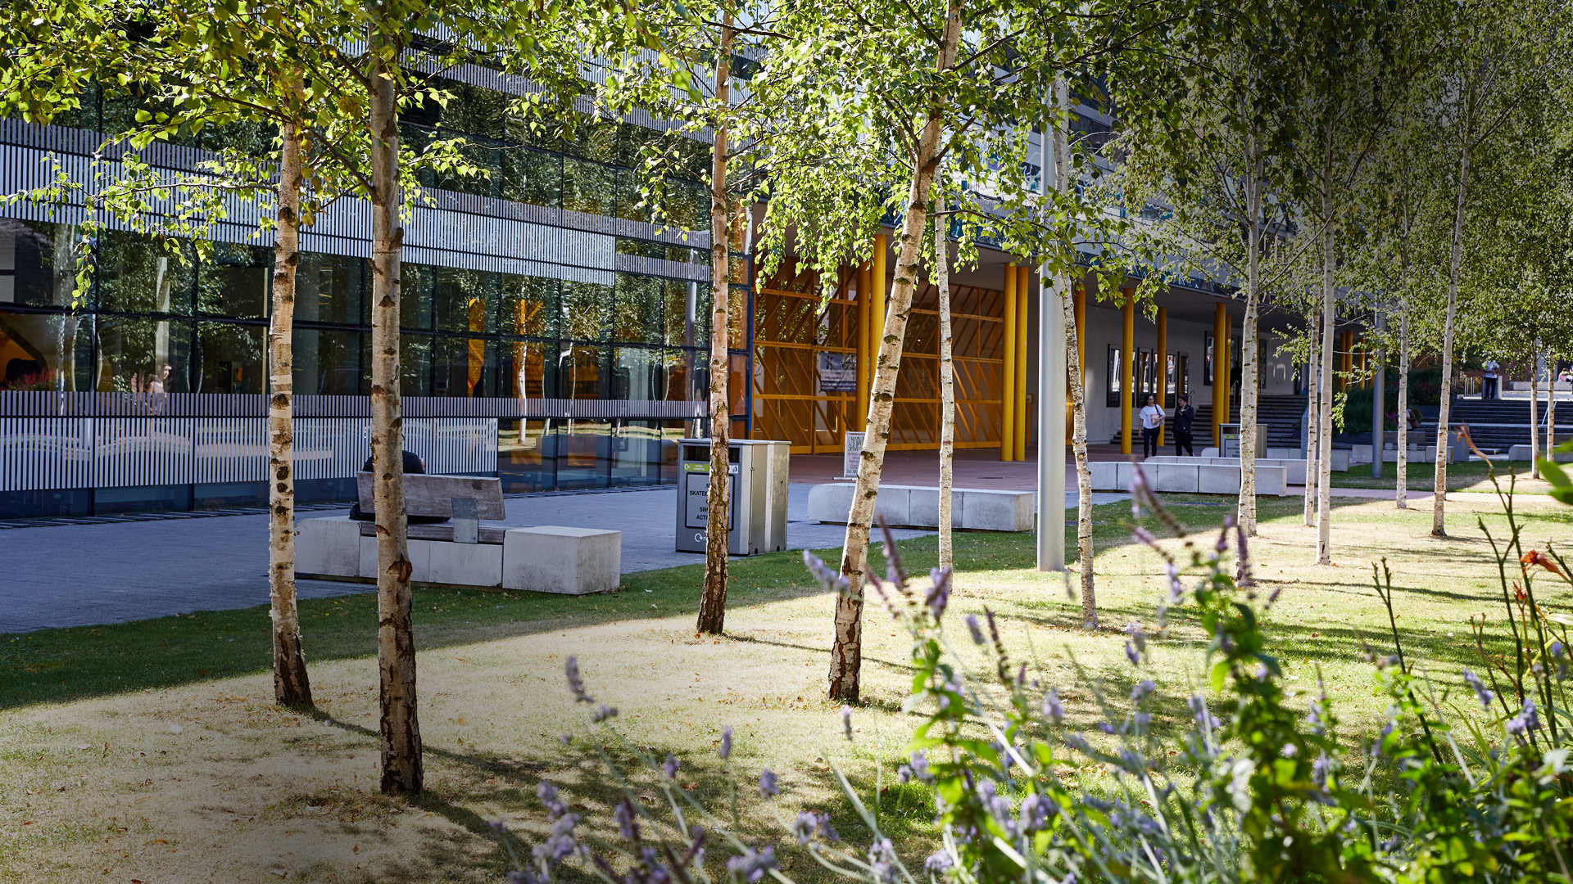
Global Challenge Research Fund - Overview

Slide 64

Global Challenge Research Fund– some basics
Established
2016
Funds available
£1.5 billion
Classification of funds
Official Development Assistance

Slide 65
Global Challenge Research fund – some basics
Administration
Administered through delivery partners including the Research Councils and national academies
Supporting cutting-edge research that addresses the challenges faced by LMIC countries through:
- challenge-led disciplinary and interdisciplinary research
- strengthening capacity for research and innovation within both the UK and LMIC countries
- providing an agile response to emergencies where there is an urgent research need
Work that is supported

Slide 66

GCRF– delivery partners
Link to RCUK GCRF page
Notes:
RCUK - most important and big player

Slide 67
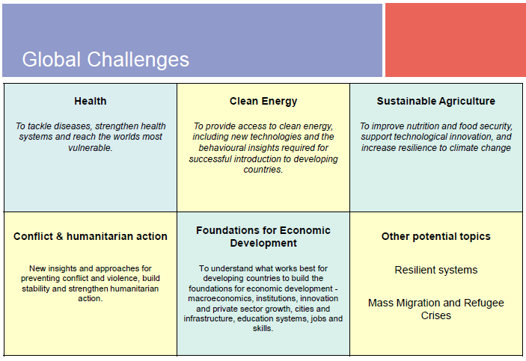
GCRF– the challenges

Slide 68

GCRF– Linked to Sustainability Development Goals (SDGs)
And the UK Aid Strategy

Slide 69
HELP Project Aims
... implementation of safe and sustainable energy solutions for lighting, electrification, cooking, heating and cooling, and water and sanitation that promotes development and improves wellbeing in displaced communities…
and the associated ICT-based business processes that enable replication and scalability.
Increase the access to affordable and sustainable energy
Introduce new principles for the design, procurement and provision of energy products and services

Slide 70
Project Objectives
Expand the evidence base upon which decisions about demand for energy services are made
Translate research findings into 'design for displacement' protocols and prototypes
Design, implement and monitor energy systems for 80 households that connects people, products, processes and policies in Rwanda and Nepal
Contribute to the scientific knowledge base on energy access, energy demand, energy provision and energy monitoring
Notes:
Expand the evidence base upon which decisions about demand for energy services amongst forcibly displaced communities and humanitarian agencies in Africa and Asia are made; by building up a portfolio of qualitative and quantitative case studies based on primary fieldwork with displaced people, humanitarian workers and energy providers in the Kigeme, Nyabiheke, Gihembe camps in Rwanda and a refugee camp in Nepal; and publishing these as reports in collaboration with UNESCO UNITWIN Network in Humanitarian Engineering.
Translate research findings into 'design for displacement' protocols and prototypes for use by humanitarian agencies in procurement processes and by the private sector in the future production of sustainable technologies for lighting, cooking and decentralised energy generation; seek feedback from key stakeholders through twelve "Design-athons for displacement" workshops in the UK, Rwanda and Nepal.
Design, implement and monitor energy systems for 80 households that connects people, products, processes and policies in Rwanda and Nepal. The beneficiaries would be made up of approximately 480 people consisting of 200 children, 180 women, and 100 men. The project aims to work with 80 women for the cooking system (20 from each of the four refugee camps), 80 youths for the mobile lighting system, and 80 households for the microgrid system.
Contribute to the scientific knowledge base on energy access, energy demand, energy provision and energy monitoring in contexts of forced displacement and global poverty through ten contributions to peer reviewed academic journals.

Slide 71
Overall project concept

Slide 72
Project Delivery: Research Questions
How do refugees use energy and what are their energy needs and aspirations?
Based on the baseline survey of energy practice, how can displaced settlements be provided with energy (for cooking, lighting and power) in a sustainable manner to enable increases in health, well-being and productivity?
How can wireless sensor networks monitoring and user-driven control of energy systems be used to understand and promote/support user preferences and patterns for energy use?
How can intelligent energy supply and demand systems be integrated with sustainable digital business processes to promote energy efficiency, social cohesion and economic growth in refugee communities?

Slide 73
Effecting Change
Social
Economic
Political
Observe
Measure
Understand
Intervene
Evaluate

Slide 74
Innovation
Methods
Social Sciences
Innovation
Technologies
Engineering/Computer Science
Processes
Business

Slide 75
Interventions
Household level | Lighting
 | Cooking
 | Devices
Functional Level | Street lighting
 | Mobile lighting
Community level | Microgrid coverage (Households, Business, Community Infrastructure)
4 Sites : Nepal & Rwanda | Light
 | Cooking
 | Energy
New systems: Installation & associated monitoring |  | Current systems: Usage monitoring
Quantitative & Qualitative | Real-time & Off-line |  | Measured & Self-reported
Energy systems for 80 households: 480 people
80 cooking systems | 80 lighting systems (mobile/street) | 80 households microgrid

Slide 76
Refugees, communities, energy system, users
A
Understand needs
Explore tech. choices
Emerge Solutions Proposals (wider picture)
User co-design (specific solutions)
Deploy
Survey
Desk & Field
D4D
E4E
Field
Phase 1
Observe
Analyse
Consult
Involve
A
Observe Usage, utility, effectiveness, fitness for purpose
Evaluate
+ Lessons
No
Involve
Needs fulfilled?
Phase 2
Survey
Field/Desk
Analyse
Yes
Policy + Lessons
Scale-up
Invovle
Recipes
Involve

Slide 77
Technology
Monitoring Solutions
(Sense)
Invent, Innovate, Deploy
Technology
Energy Solutions (Control)
Rethink, innovate, deploy, evaluate, analyse, capitalise

Slide 78
Instrumentation
Device level energy usage---appliances
Product level usage---mobile lighting, street lighting
Indoor air pollution evaluation---cooking
Outdoor air pollution evaluation---cooking
Microgrid sub-system monitoring (generation & demand)
Metering & Billing (Consumer units monitoring)
User owned-energy usage tracking evaluation facility
Community owned---energy generation and usage tracking facility
Community owned devices---energy distribution control devices

Slide 79
Project Impact: Partners
UN's global organisations (e.g. UK National Commission for UNESCO for the UNITWIN Network in Humanitarian Engineering)
Existing third sector networks (e.g. Practical Action with their links to the Moving Energy Initiative), and
Government (e.g. Scene Connect's advisory role with the Scottish government on the Local Energy Challenge Fund (LECF) for the development and impact of community renewables projects in Scotland).

